Slide 1

Stroke Prediction
Vinay Nagaraj
DSC680, Summer 2021
Bellevue University, NE

Slide 2
Problem Statement
Stroke is the 2nd leading cause of death globally, responsible for approximately 11% of total deaths.
Detecting Stroke at an early stage and providing medication for that is very crucial to a patient's health condition.
This project intends to predict the patients with high risk and have higher chance of stroke.

Slide 3
Process Overview
Preliminary analysis on data
Data preparation and cleaning for any missing values.
Perform Exploratory Data Analysis
Train and test models
Model evaluation and tuning

Slide 4
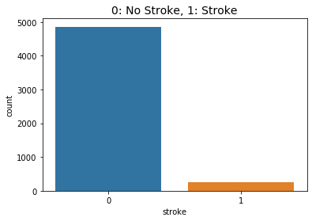
Dataset Overview
The dataset is downloaded from Kaggle which contains details of patients.
Out of 5,110 records, 249 are data related to patients who had stroke.
Highly Unbalanced dataset – SMOTE.

Slide 5
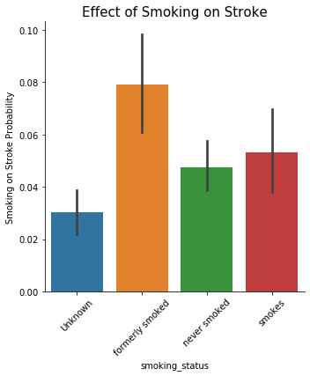
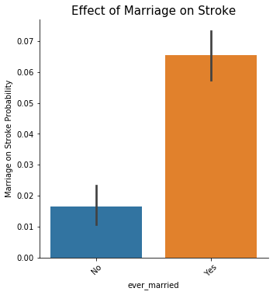
Graph Analysis
Being a smoker or a formerly smoker increases your risk of having a stroke.
Married patients have a higher chance of Stroke.

Slide 6
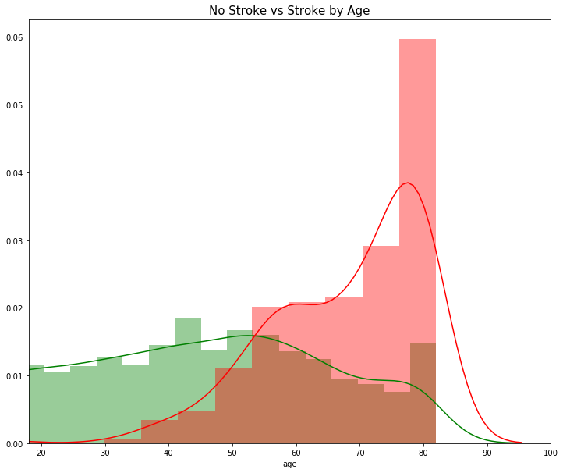
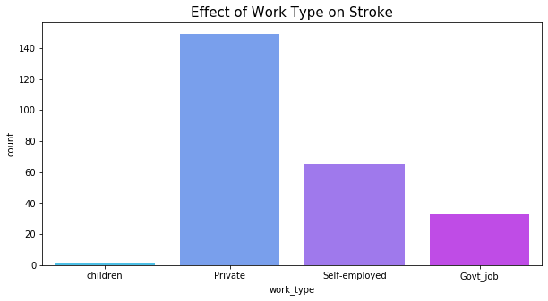
Graph Analysis
Age is a big factor in stroke patients - the older you get the more at risk you are.
Private work type exposes your chance to a Stroke more than being self-employed or Govt work.

Slide 7
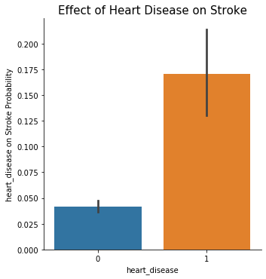
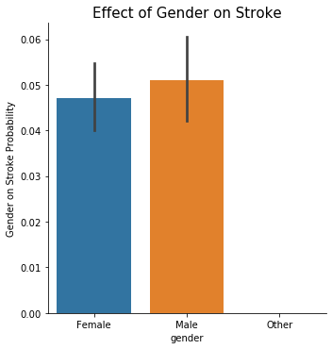
Graph Analysis
People with a history of heart disease are more prone to Stroke.
Male patients are more prone to Stroke when compared to Female patients.

Slide 8
SMOTE - Oversampling
Oversampling increases the number of minority class members in the training set.
SMOTE creates synthetic points from the minority class and makes our dataset balanced.

Slide 9
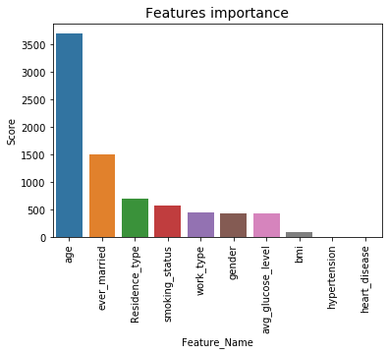
Feature Importance
Target variable – “Stroke” which determines if the patient had a stroke or not.
SelectKBest technique used to identify most relevant features.
‘Age’ plays a vital role in predicting Stroke.

Slide 10
Random Forest Model
Random Forest Model provides us a high true prediction values for our dataset.
88.71% of the time, our model will correctly predict if the patient will have a Stroke or not.

Slide 11
k-nearest neighbors (KNN)
83.3% of the time, our model will correctly predict if the patient will have a Stroke or not.

Slide 12
Decision Tree
85.91% of the time, our model will correctly predict if the patient will have a Stroke or not.

Slide 13
Conclusion
Age is an important factor in Stroke patients.
Smoking is injurious to health and can increase the chances of Stroke.
SMOTE Technique can used to overcome imbalanced data.
Random Forest Model better suited.

